Slide 1

Workshop starts at 12:02
Materials for today
To work on your browser.
https://pwrss.shinyapps.io/index/
https://shiny.ctu.unibe.ch/presize/

Slide 2
Introduction to Statistical Power Analysis
Instructor: David Nichols
TA: Jillian Whitton

Slide 3
This workshop is brought to you by:
Northwestern IT Research Computing and Data Services
Need help?
AI, Machine Learning, Data Science
Statistics
Visualization
Collecting web data (scraping, APIs), text analysis, extracting information from text
Cleaning, transforming, reformatting, and wrangling data
Automating repetitive research tasks
Research reproducibility and replicability
Programming, computing, data management, etc.
R, Python, SQL, MATLAB, Stata, SPSS, SAS, etc.
Request a FREE consultation at bit.ly/rcdsconsult.

Slide 4
What’s next?
October the 29th: Next Steps in R: Writing Your Own Functions
November the 4th: Next Steps in Python: Virtual Environments
November the 12th: AI for Research: Choosing a LLM for Your Project
November the 19th: Introduction to SQL (in-person)
November the 20th: Intermediate SQL (in-person)
December 16 – 19: Bootcamp: R Fundamentals
December 16 – 19: Bootcamp: Python Fundamentals

Slide 5
Logistics
Ask Questions [in the zoom chat].
If you know the answer, feel free to respond (we may politely clarify if needed).
Jillian will monitor and we will address questions after the presentation.
If my internet goes out.
Take a 5 minute break, and we will meet back in the same zoom room.
Power and sample size calculations to be demonstrated can be replicated using the pwrss package in R, or the linked online calculator at https://pwrss.shinyapps.io/index/.
Precision and sample size calculations to be demonstrated can be replicated using the presize package in R, or the linked online calculator at https://shiny.ctu.unibe.ch/presize/.

Slide 6
Introduction and Goals

Slide 7
Introduction to Statistical Power Analysis
Proper planning for quantitative research is a crucial and sometimes overlooked step in the research process. Studies with sample sizes that are too small to have a good chance of finding realistic effects waste time and effort and can increase the likelihood of incorrect conclusions.
This workshop will review basic concepts for hypothesis testing and statistical power and precision analysis, helping participants understand what they need to know to properly plan their statistical analyses with appropriate sample sizes. It will include a short demonstration using R software for power analysis.

Slide 8
Introduction to Statistical Power Analysis
Goals of the workshop:
Explain the basic concepts of power analysis, precision, and sample size determination
Provide some of the vocabulary necessary to identify methods, some cautions, and and some recommendations
Demonstrate use of some helpful software for power and precision analysis

Slide 9
Estimation and Testing

Slide 10
Estimation and testing: Populations and samples
We care about characteristics (or parameters) of identifiable populations, which are complete sets of things (e.g., people, animals, cells), but just going out and measuring these characteristics on entire populations is often impractical or impossible, because:
Entire populations are usually too big for us to take measurements on every unit in the population (e.g., all people in the United States), or
The populations are theoretical rather than existing (e.g., the population of interest is all people who might receive a particular treatment or react to a particular experimental situation)

Slide 11
Estimation and testing: Populations and samples
We approach this problem by:
Selecting (sampling) subsets of the populations of interest.
Collecting data from those sampled units, often following exposing those sampled units to experimental treatments or manipulations.
Using those data to compute estimates of parameters and measures of uncertainty of these estimates.
Making inferences about the parameters of entire population(s) based on the estimates from sample data.

Slide 12
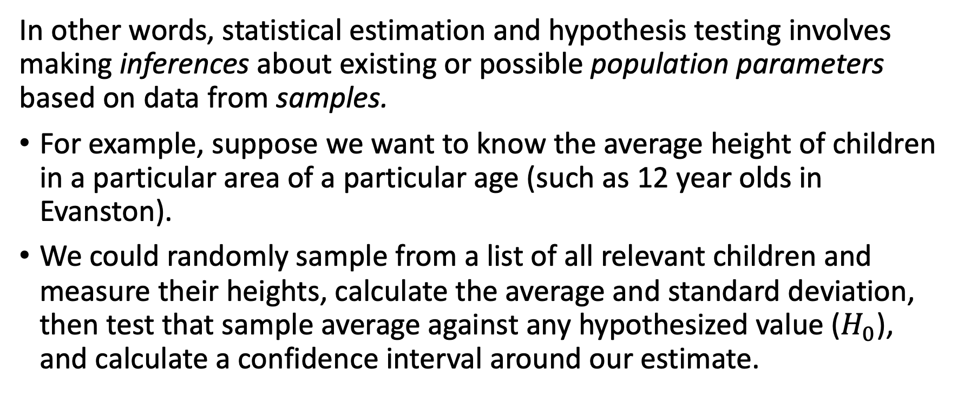
Estimation and testing: Populations and samples and an example
In other words, statistical estimation and hypothesis testing involves making inferences about existing or possible population parameters based on data from samples.
For example, suppose we want to know the average height of children in a particular area of a particular age (such as 12 year olds in Evanston).
We could randomly sample from a list of all relevant children and measure their heights, calculate the average and standard deviation, then test that sample average against any hypothesized value ($H_{0}$), and calculate a confidence interval around our estimate.

Slide 13
Estimation and testing: Frequentist vs. Bayesian
The most common approach to hypothesis testing, and the one discussed today, is what is known as the frequentist approach, which assumes that probabilities are objective values based on long-run frequencies.
An alternative approach, known as the Bayesian approach, also sometimes referred to as the subjective approach, where probabilities are degrees of belief, won’t be covered today.
Notes:
Break for poll on interest in an introductory seminar on Bayesian statistics

Slide 14
Hypothesis Testing, Types of Errors, and Power Definition

Slide 15
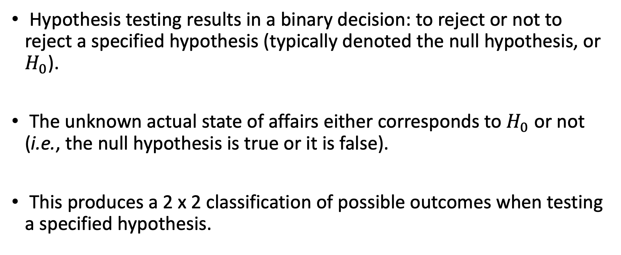
Hypothesis testing and types of errors
Hypothesis testing results in a binary decision: to reject or not to reject a specified hypothesis (typically denoted the null hypothesis, or $H_{0}$).
The unknown actual state of affairs either corresponds to $H_{0}$ or not (i.e., the null hypothesis is true or it is false).
This produces a 2 x 2 classification of possible outcomes when testing a specified hypothesis.

Slide 16
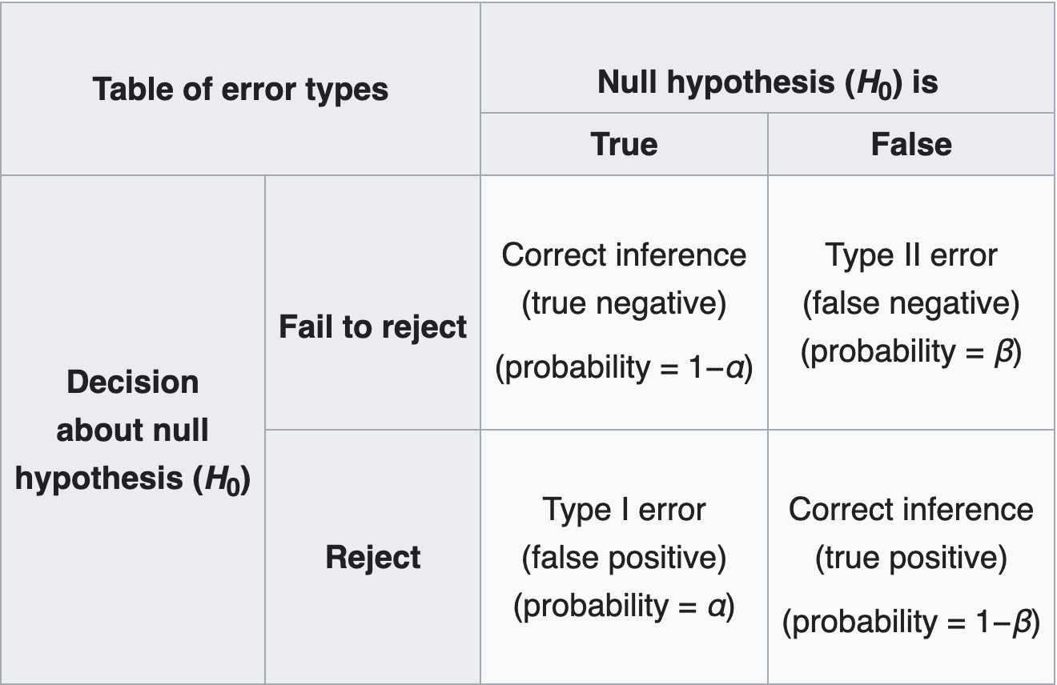
Hypothesis testing and types of errors
Power
Source: Wikipedia (https://en.wikipedia.org/wiki/Type_I_and_type_II_errors)

Slide 17
Power Calculation Fundamentals

Slide 18
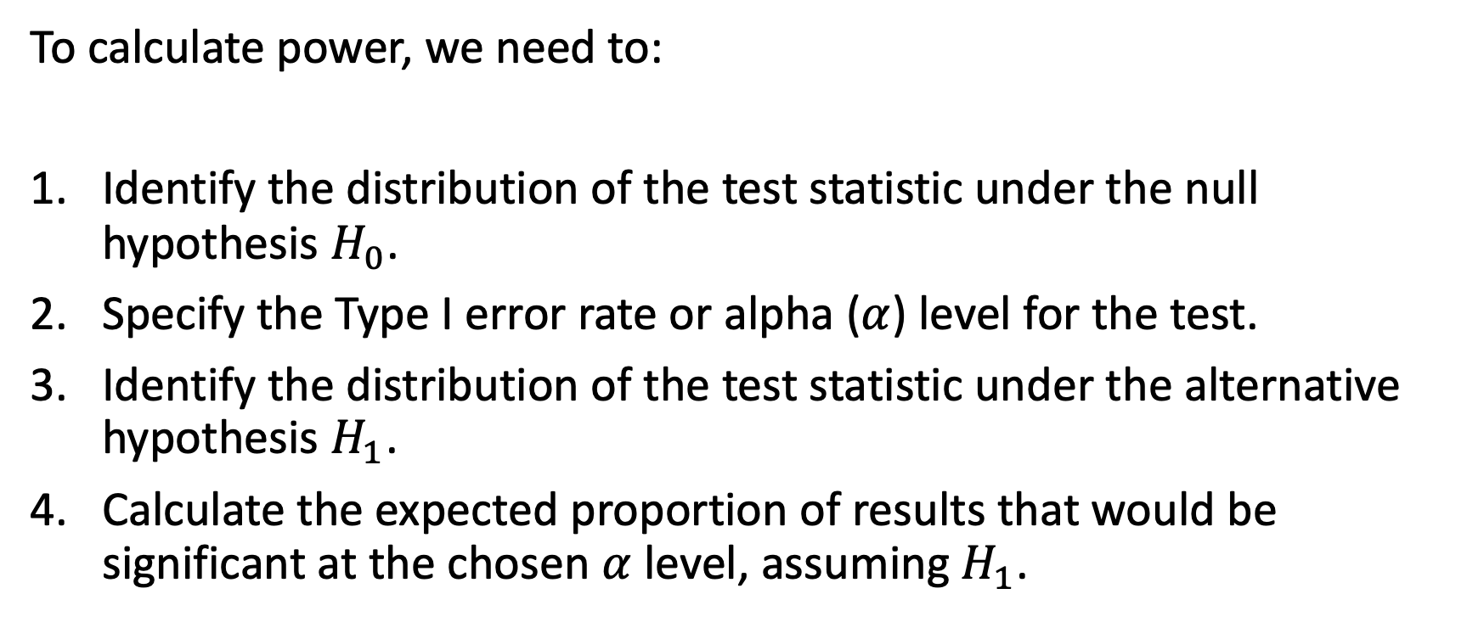
Calculating power: null and alternative distributions
To calculate power, we need to:
Identify the distribution of the test statistic under the null hypothesis $H_{0}$.
Specify the Type I error rate or alpha ($α$) level for the test.
Identify the distribution of the test statistic under the alternative hypothesis $H_{1}$.
Calculate the expected proportion of results that would be significant at the chosen $α$ level, assuming $H_{1}$.

Slide 19
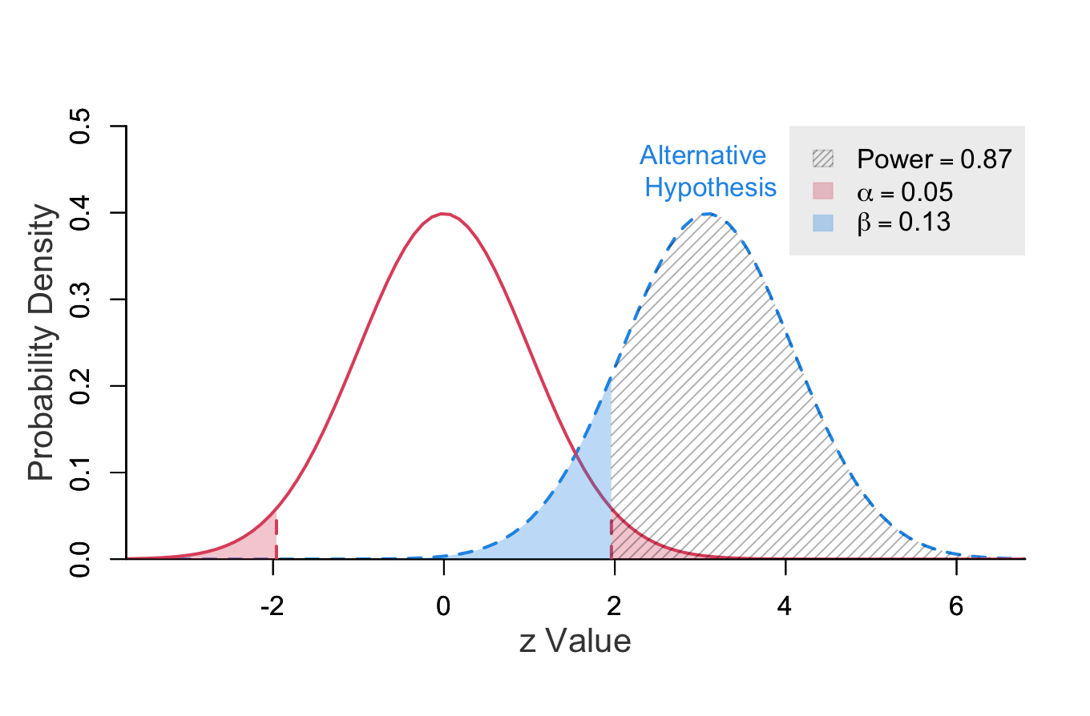
Null and alternative distributions and power: Symmetric distributions
Source: R package pwrss

Slide 20
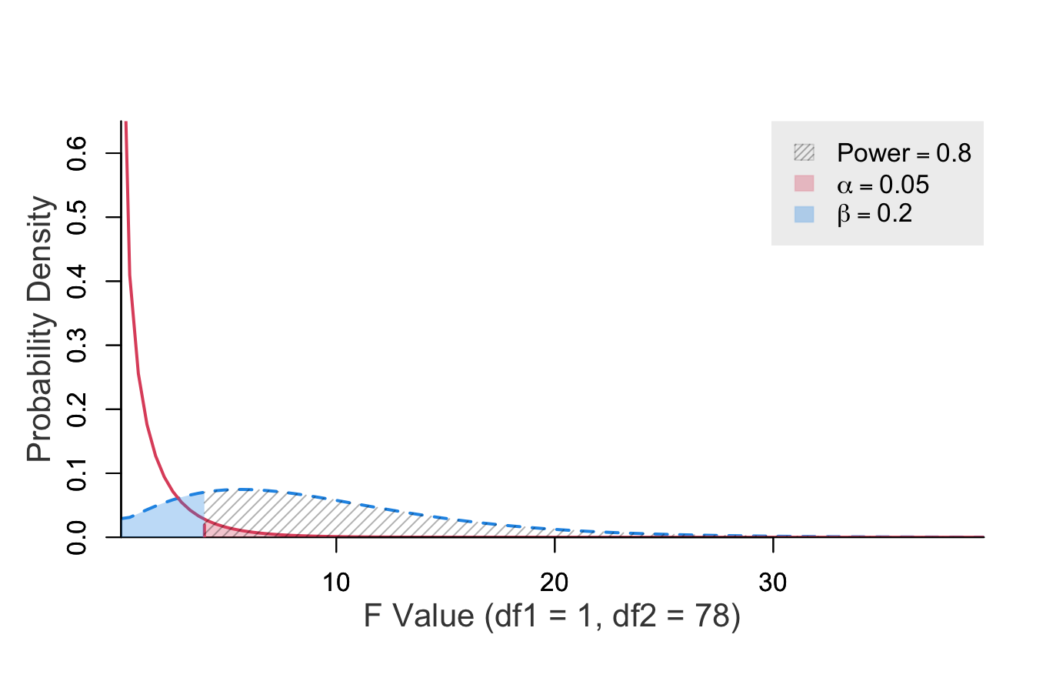
Null and alternative distributions and power: Asymmetric distributions
Source: R package pwrss

Slide 21
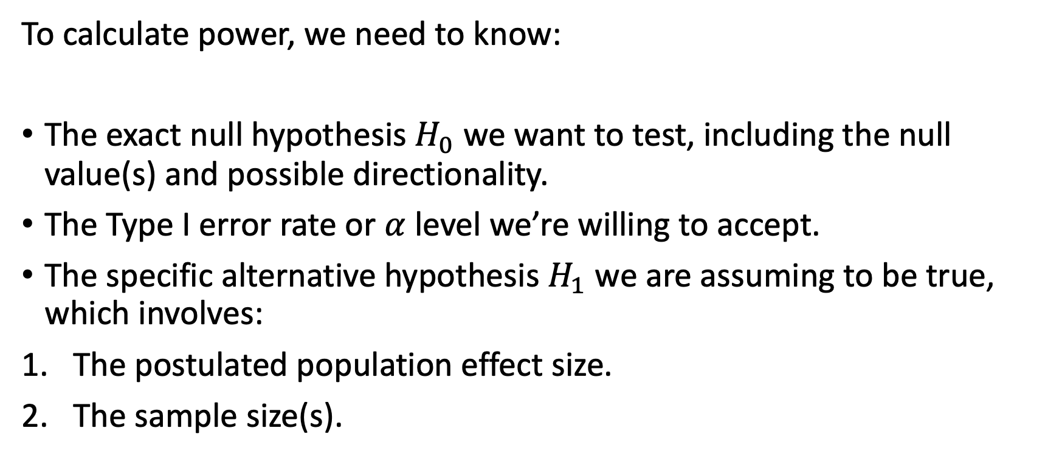
What we need to know to calculate power
To calculate power, we need to know:
The exact null hypothesis $H_{0}$ we want to test, including the null value(s) and possible directionality.
The Type I error rate or $α$ level we’re willing to accept.
The specific alternative hypothesis $H_{1}$we are assuming to be true, which involves:
The postulated population effect size.
The sample size(s).

Slide 22
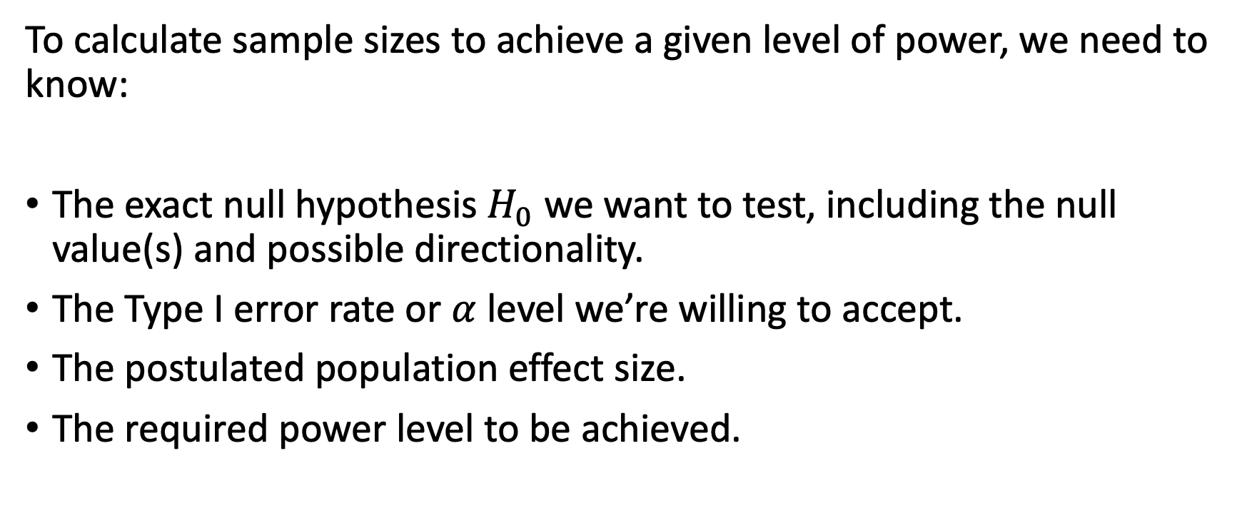
What we need to know to calculate sample sizes
To calculate sample sizes to achieve a given level of power, we need to know:
The exact null hypothesis $H_{0}$ we want to test, including the null value(s) and possible directionality.
The Type I error rate or $α$ level we’re willing to accept.
The postulated population effect size.
The required power level to be achieved.

Slide 23
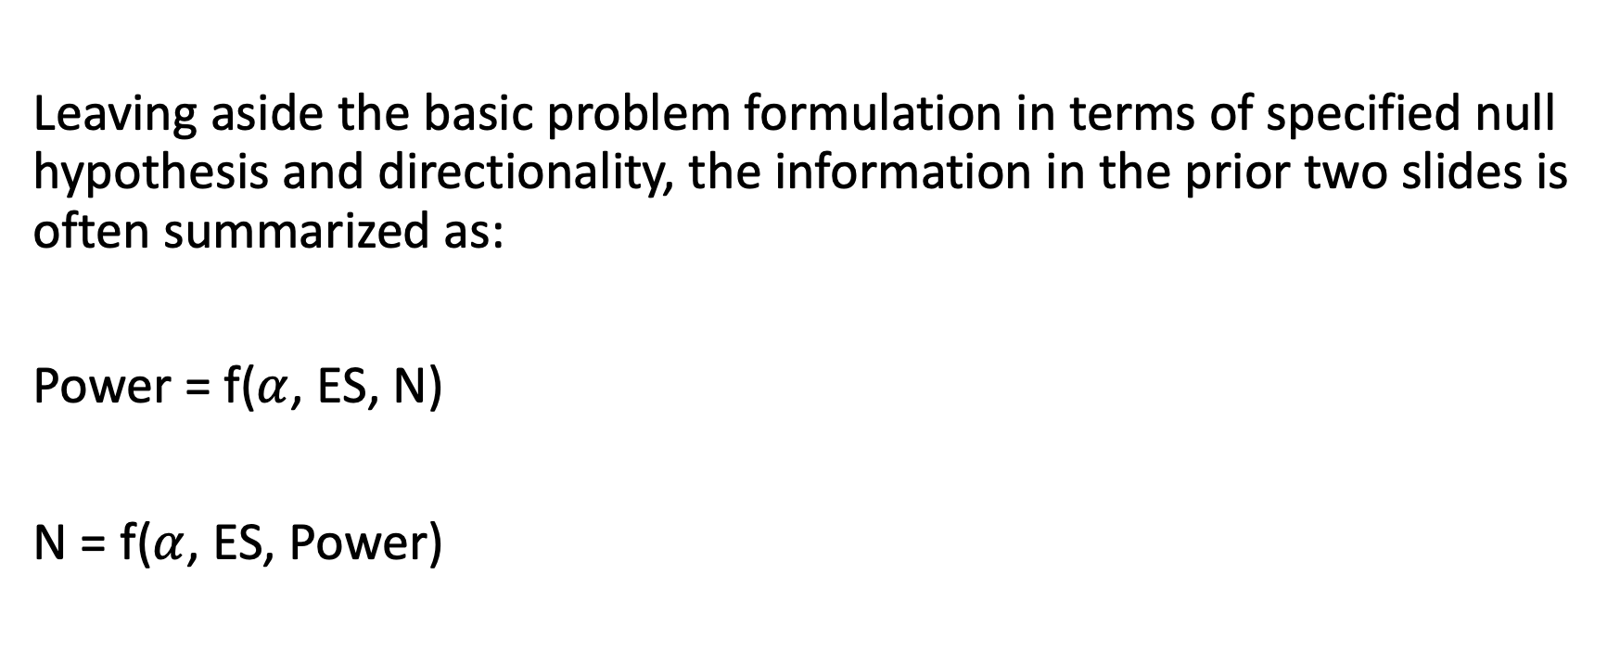
Power and sample size functions
Leaving aside the basic problem formulation in terms of specified null hypothesis and directionality, the information in the prior two slides is often summarized as:
Power = f($α$, ES, N)
N = f($α$, ES, Power)

Slide 24
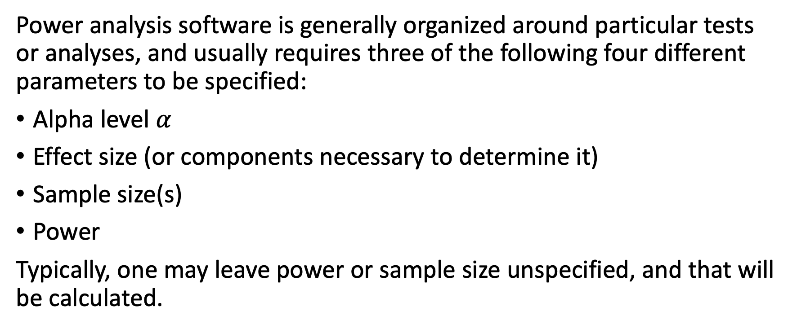
Power analysis software inputs and outputs
Power analysis software is generally organized around particular tests or analyses, and usually requires three of the following four different parameters to be specified:
Alpha level $α$
Effect size (or components necessary to determine it)
Sample size(s)
Power
Typically, one may leave power or sample size unspecified, and that will be calculated.

Slide 25
Effect Sizes

Slide 26
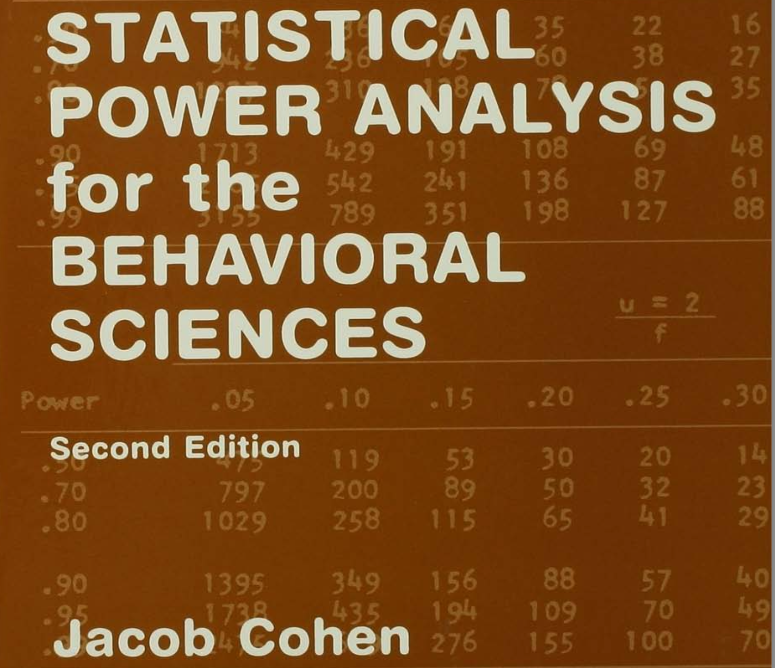
Power pioneer: Jacob Cohen
Jacob Cohen was a psychologist and statistician who pioneered the use of power analysis and effect sizes.
He also made numerous other important contributions to statistical analyses in the social sciences.

Slide 27
What is an effect size? Cohen’s take
The term “effect size” has been defined or referred to in a number of related but not identical ways.
Cohen (1988, pp. 9-10): “Without intending any necessary implication of causality, it is convenient to use the phrase ‘effect size’ to mean ‘the degree to which the phenomenon is present in the population,’ or ‘the degree to which the null hypothesis is false.’”
A corollary of this definition is that if a null hypothesis is true, the relevant effect size must be 0.

Slide 28
A modern definition of effect size
Kelley and Preacher (2012 Psychological Methods, Vol. 17, no. 2, pp. 137-152) provide a more general definition: “Effect size is defined as a quantitative reflection of the magnitude of some phenomenon that is used for the purpose of addressing a question of interest (p. 140).”
Notice that this definition does not mention null hypotheses or significance tests. This is in part because a particular effect size can be different in the context of testing different null hypotheses.
It is also more general in not confining the term to just population values, also encompassing sample values.
Finally, it makes the important linkage to a question of interest, which orients us to the purposes of what we’re doing.

Slide 29
Effect sizes: “Raw” vs. standardized
Effect sizes in general can be expressed either in natural or “raw” units, or in standardized units.
Standardization typically involves dividing raw differences by measures of variability (usually standard deviations).
Unstandardized units may be easier to interpret for a particular variable and context.
Standardized units make it easier to compare effect sizes across different variables and/or contexts.
Power analysis generally requires transforming effect sizes to standardized units.

Slide 30
Types of effect sizes
There are dozens of effect size measures.
These can be broadly categorized as belonging to three types:
Measures based on mean differences
Measures based on correlations or variance “explained”
Measures based on associations among categorical variables
Some of these can be transformed into each other (where analyses are equivalent).

Slide 31
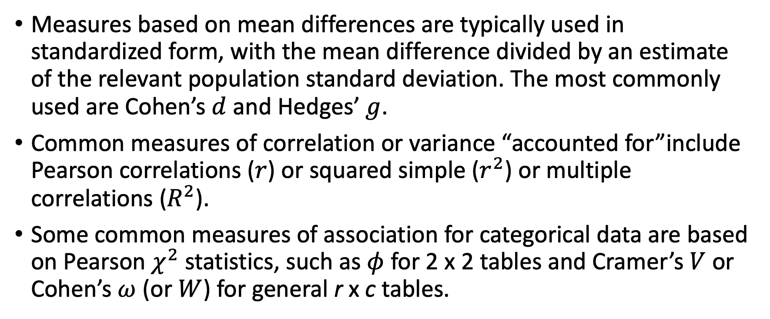
Examples of commonly-used effect sizes
Measures based on mean differences are typically used in standardized form, with the mean difference divided by an estimate of the relevant population standard deviation. The most commonly used are Cohen’s $d$ and Hedges’ $g$.
Common measures of correlation or variance “accounted for”include Pearson correlations ($r$) or squared simple ($r^{2}$) or multiple correlations ($R^{2}$).
Some common measures of association for categorical data are based on Pearson $χ^{2}$ statistics, such as $φ$ for 2 x 2 tables and Cramer’s $V$ or Cohen’s $ω$ (or $W$) for general r x c tables.

Slide 32
Effect Sizes: The Hardest Part

Slide 33
The hardest piece: Specifying effect sizes
The most difficult aspect of setting up a power analysis or sample size determination can be the specification of an appropriate population effect size.
Target effect sizes are often chosen based on prior research, either:
Research on the same or similar phenomena published by other researchers.
Pilot studies.
Both of these approaches can have problems.

Slide 34
Estimating effect sizes: Complexities
Published research can be problematic because there may not be good studies on the same or a sufficiently close issue, and what is published may be biased towards positive effect sizes (due to “the file drawer problem”).
Both approaches can also be problematic because measured effect sizes are only estimates, subject to error variability, so you need to consider the range of reasonable effect size values, not just the point estimate.
With small pilot studies, the range of plausible estimates can be quite wide.

Slide 35
Specifying effect sizes: Some options
When basing specified effect sizes on prior research (published by others or your own pilot studies), using the lower confidence interval bounds for estimated effects instead of the point estimates can help protect against overestimation of actual population effect sizes.
However, this does not necessarily overcome publication biases of existing published research.
Serious publication bias can result in the entire estimated interval being too optimistic.

Slide 36
Specifying effect sizes: Recommendations
I do not recommend simply using “small,” “medium,” or “large” values specified by Jacob Cohen or others (“the reader is counseled to avoid the use of these conventions, if he can, in favor of exact values provided by theory or experience in the specific area in which he is working.” Cohen (1988), p. 184).
These are subjective, based on particular research areas, and might not be appropriate for your area.
An approach I would recommend is to use the smallest effect size that you would consider of theoretical or practical importance.
It’s important to know your research area so that you can specify realistic effect sizes.

Slide 37
Exercises: Power Analysis and Sample Size Determination

Slide 38
Power analysis exercises
Evaluate the power of a test of a single expected mean equal to .3 times the population standard deviation vs. a null value of 0, with a sample size of 50.
Calculate the necessary sample size for the above scenario to achieve power of at least .8.
Evaluate the power of a test of an expected .55 proportion against a null proportion of .5, with a sample size of 500, using the “not equal” alternative hypothesis, and arcsine transformation method.
Calculate the necessary sample size for the above scenario to achieve power of at least .9.

Slide 39
Software demonstration: Power analysis
For power analysis, we’ll use the Shiny app associated with the R pwrss package:
https://pwrss.shinyapps.io/index/

Slide 40
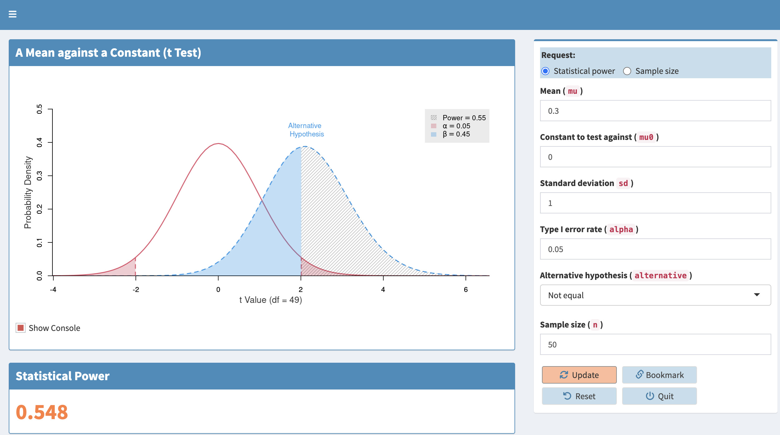
Power exercise 1

Slide 41
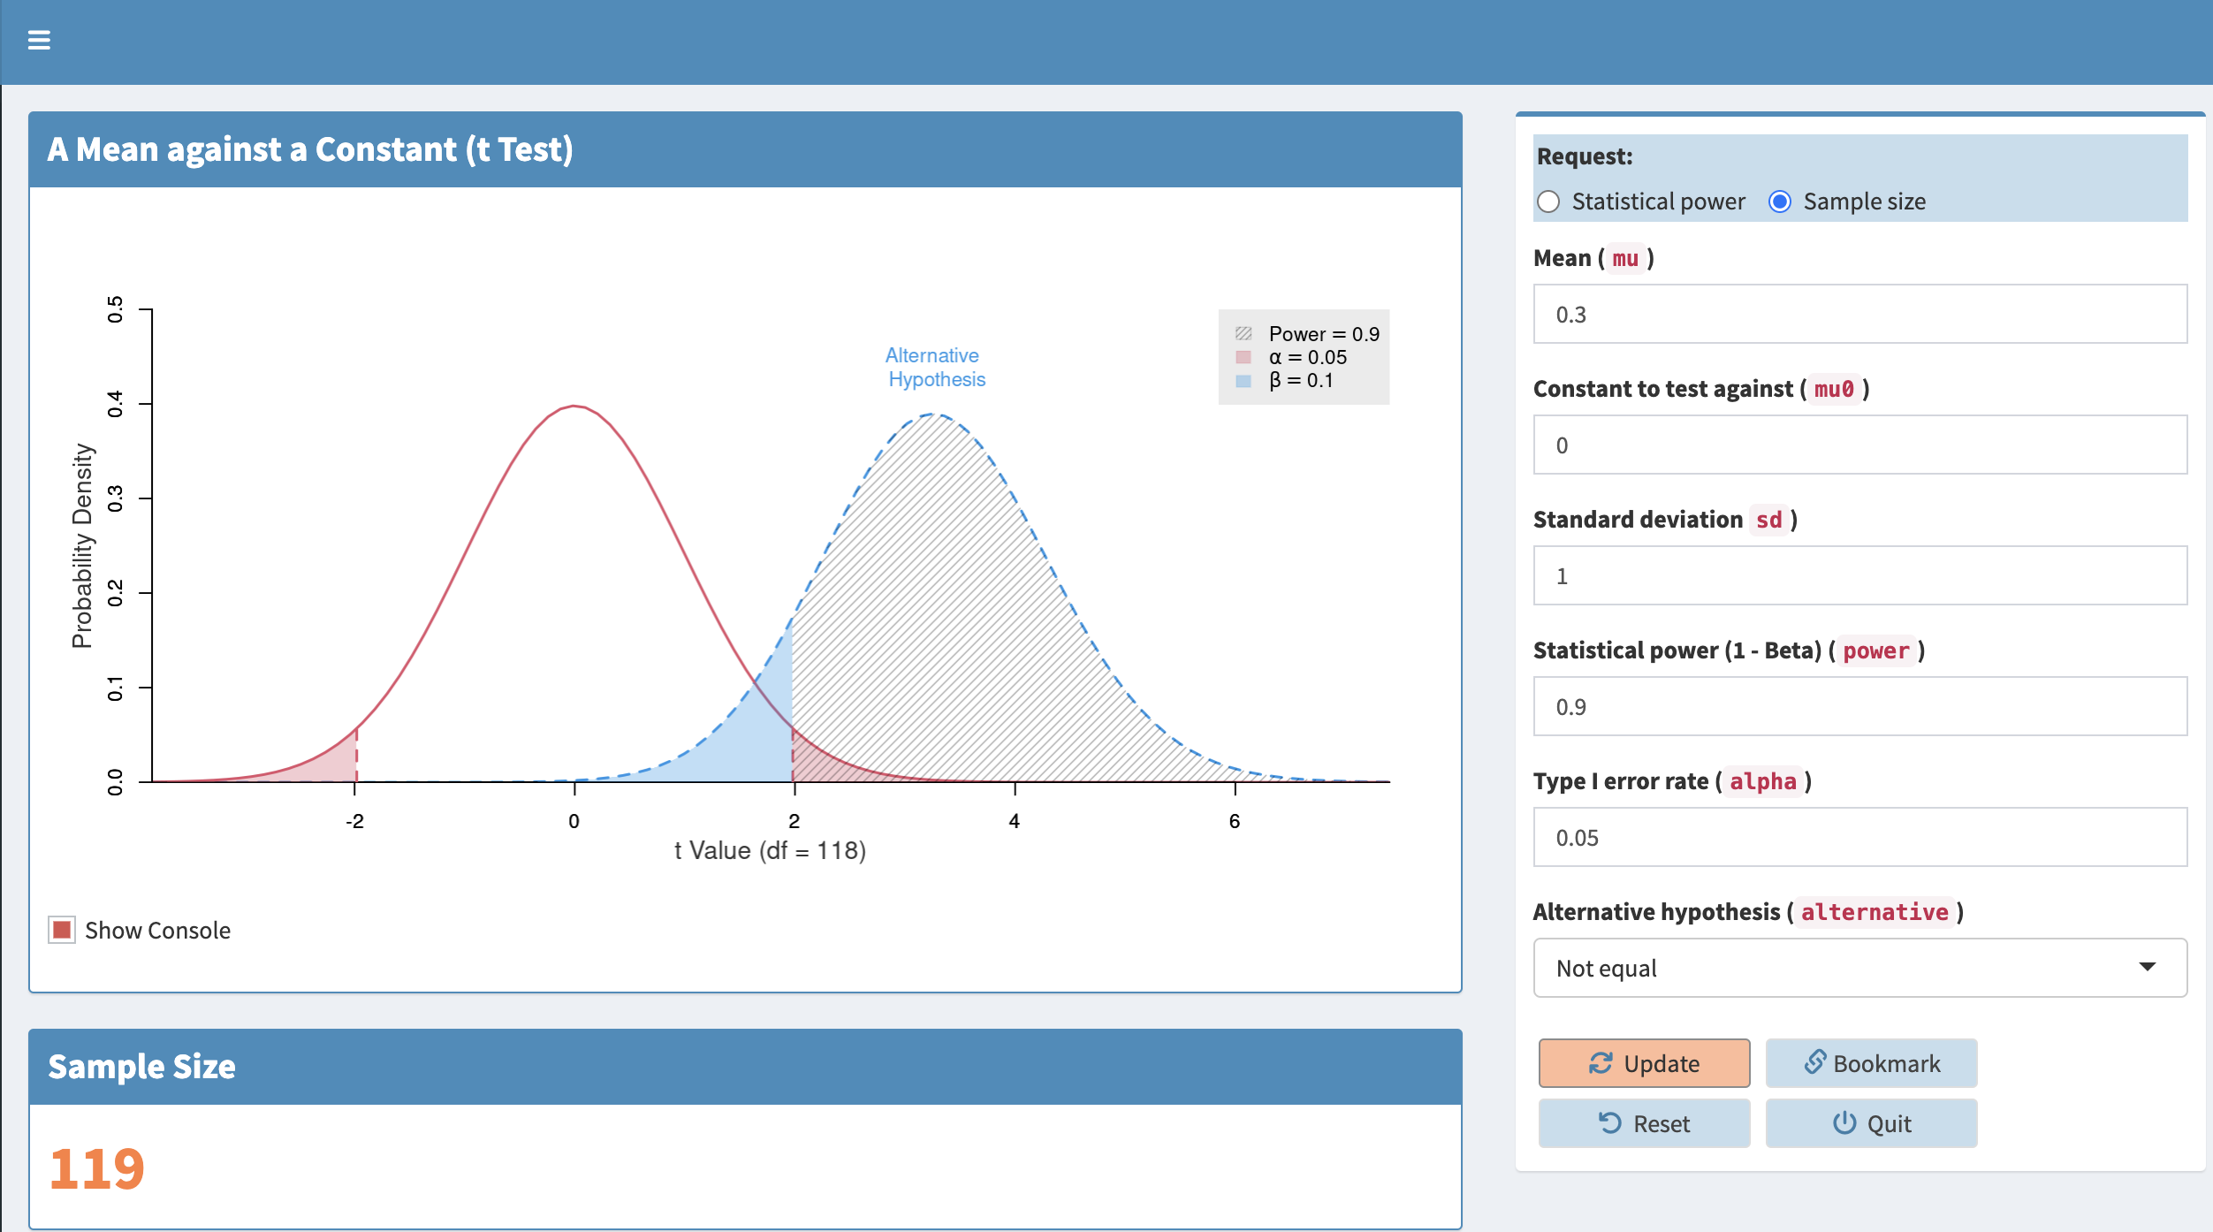
Power exercise 2

Slide 42
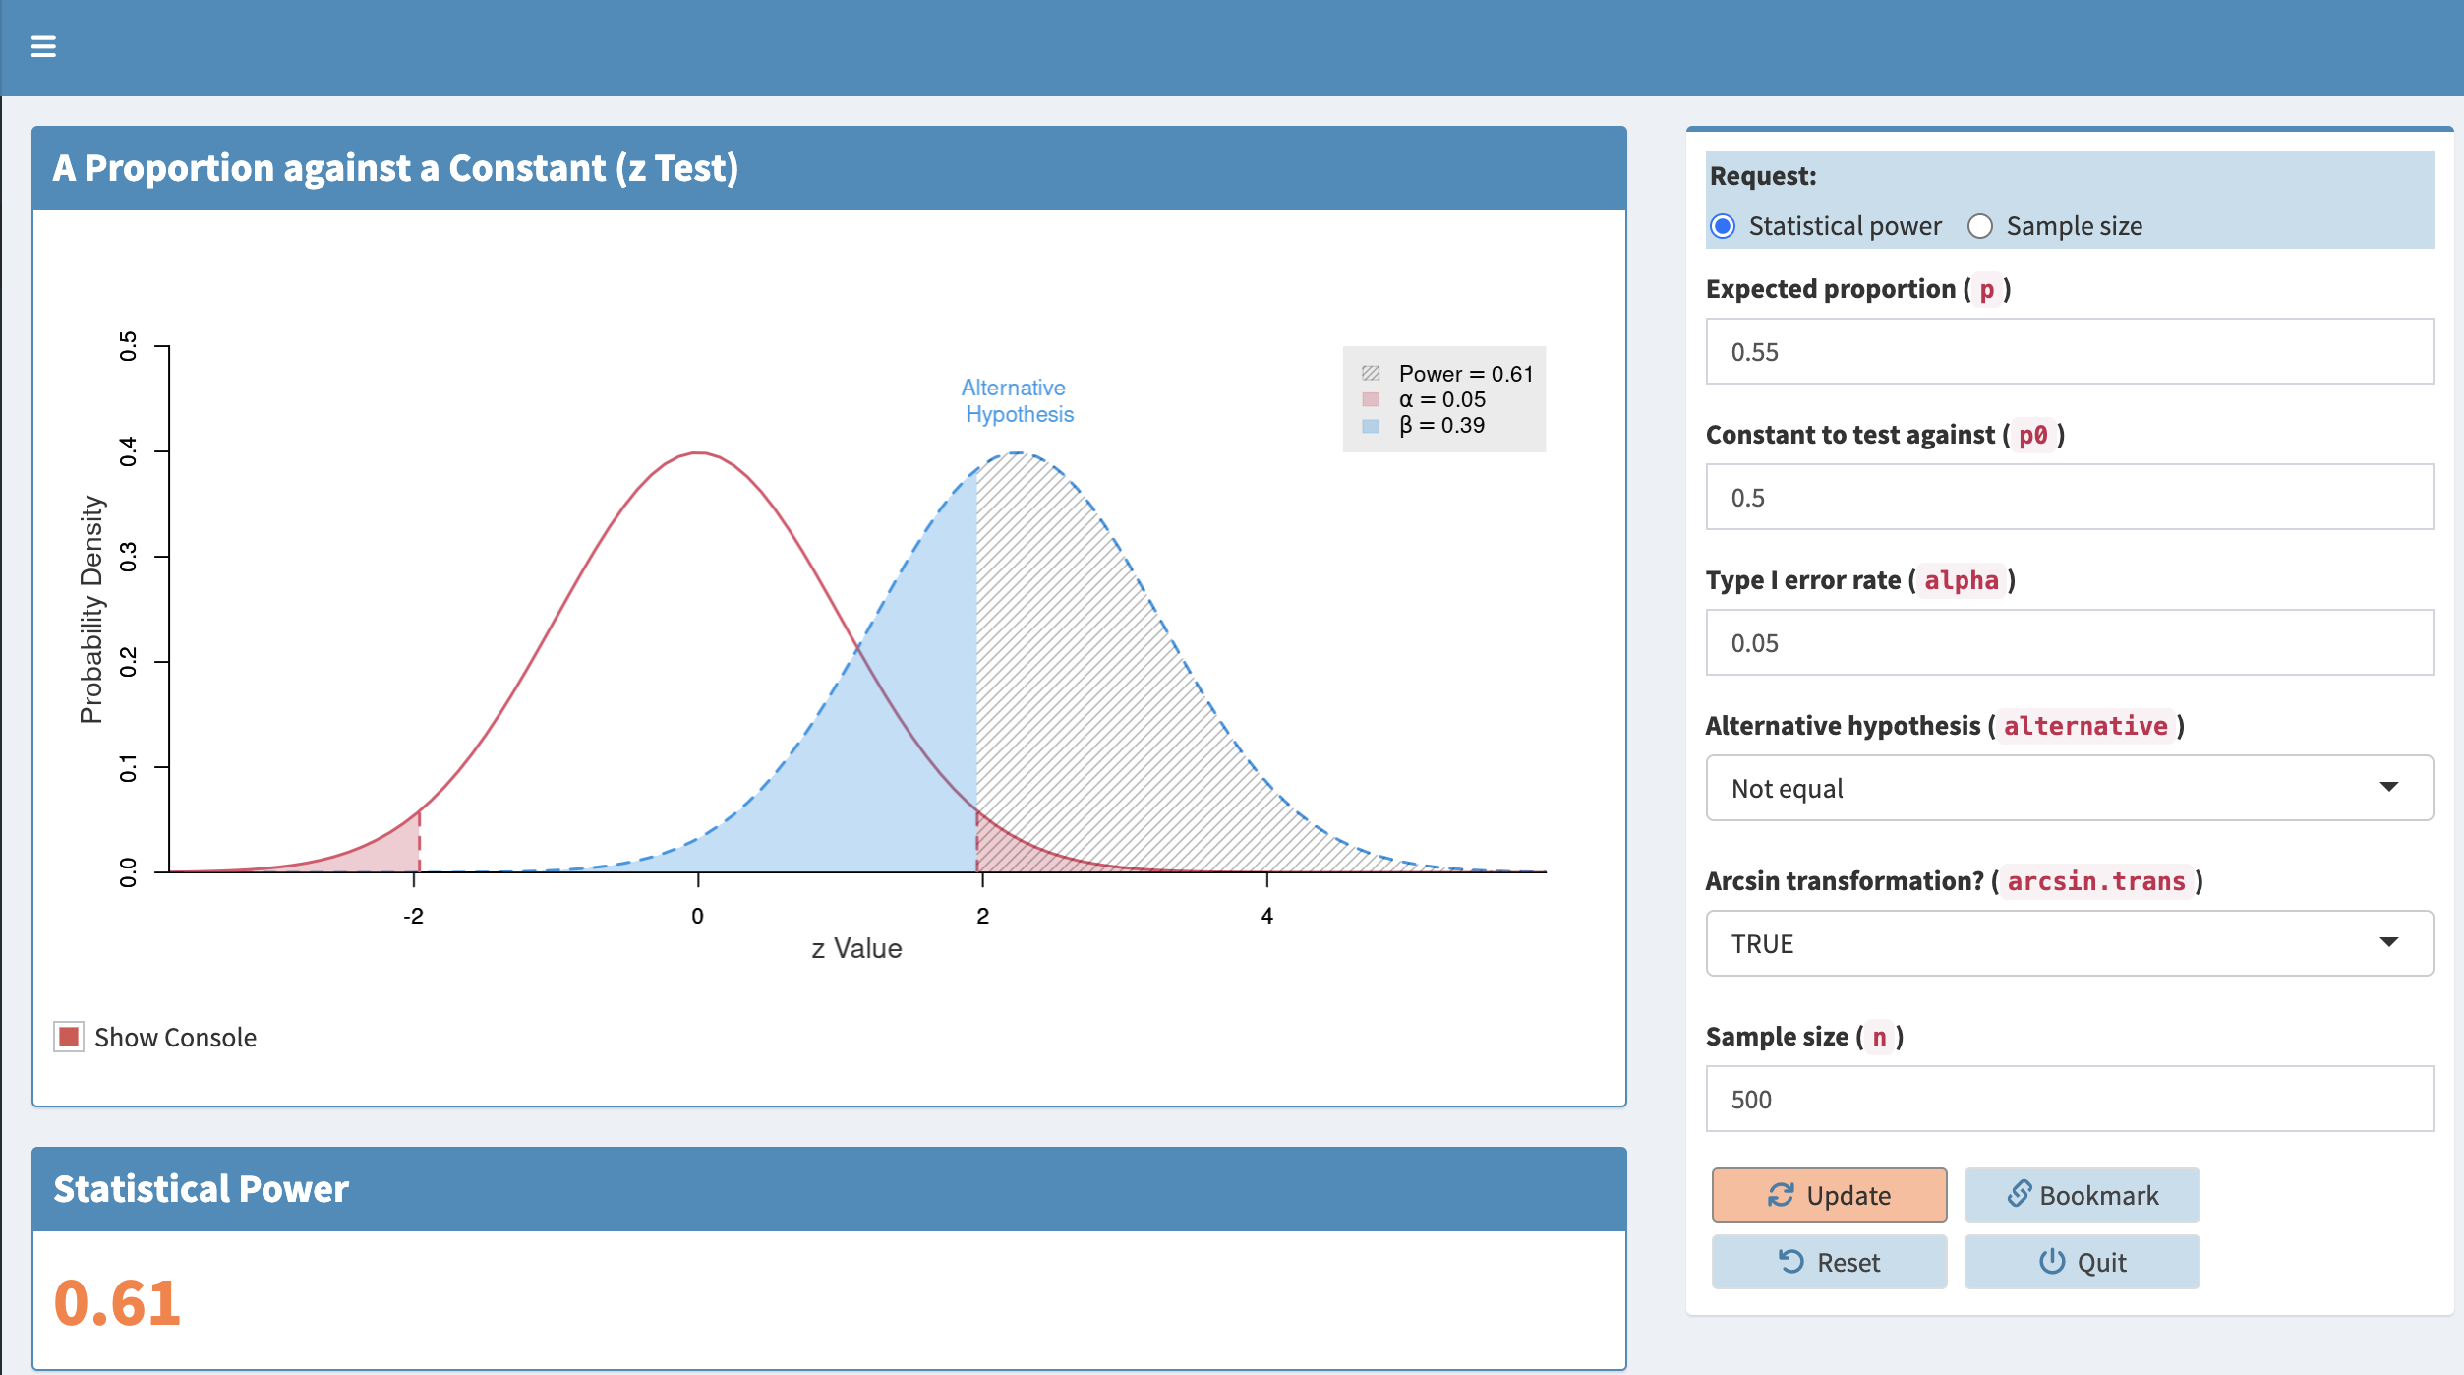
Power exercise 3

Slide 43
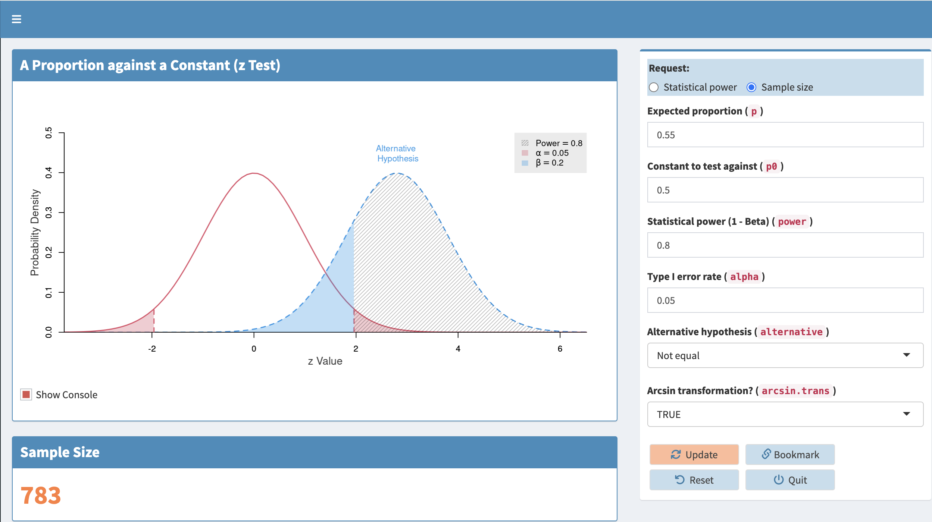
Power exercise 4

Slide 44
Exercises: Power Analysis and Sample Size Determination

Slide 45
Power and precision
So far we’ve been discussing things in terms of testing hypotheses, but many statisticians and researchers argue that we should focus more on estimates of population parameters and the amount of precision involved.
This precision can be assessed by the width of confidence intervals.
For many common analyses confidence intervals are symmetric, and the half-width of an interval is a useful measure of precision (the “plus or minus” amount).
The width or half-width of a confidence interval is usually closely tied to the power of a related test.

Slide 46
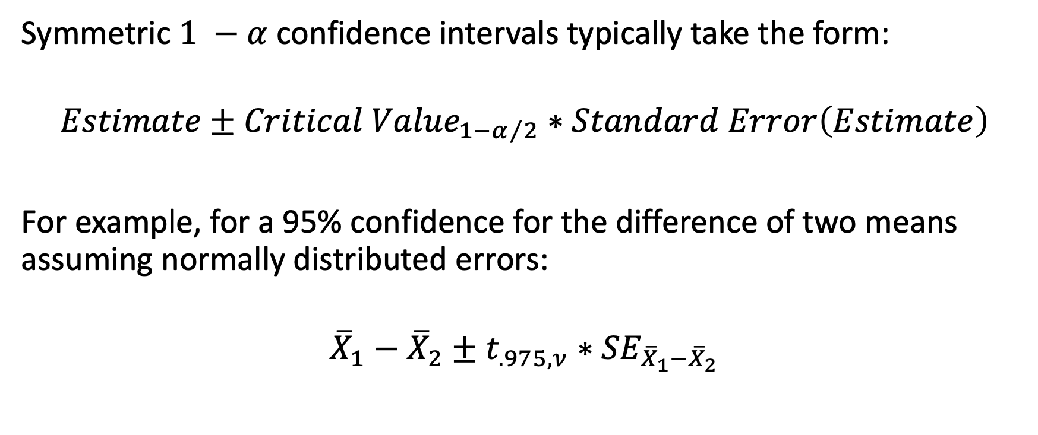
Confidence interval precision and sample size: Symmetric intervals
Symmetric $1 −α$ confidence intervals typically take the form:
$$Estimate±{Critical Value}_{1−α/2}∗Standard Error\left(Estimate\right)$$
For example, for a 95% confidence for the difference of two means assuming normally distributed errors:
$${\overline{X}}_{1}−{\overline{X}}_{2}±t_{.975,ν}∗{SE}_{{\overline{X}}_{1}−{\overline{X}}_{2}}$$

Slide 47
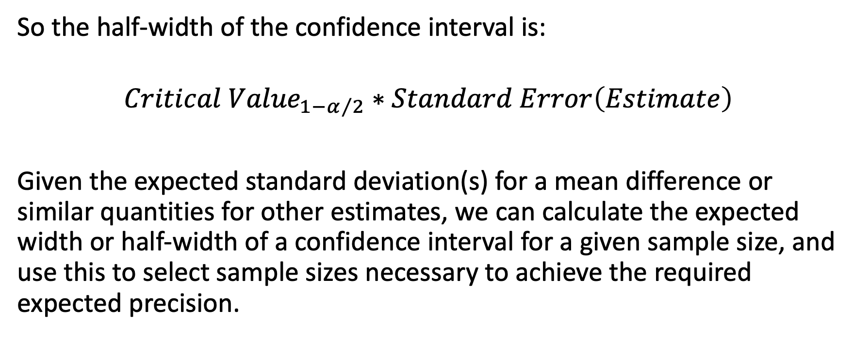
Confidence interval precision and sample size: Symmetric intervals
So the half-width of the confidence interval is:
$${Critical Value}_{1−α/2}∗Standard Error\left(Estimate\right)$$
Given the expected standard deviation(s) for a mean difference or similar quantities for other estimates, we can calculate the expected width or half-width of a confidence interval for a given sample size, and use this to select sample sizes necessary to achieve the required expected precision.

Slide 48
Confidence interval precision and sample size: Asymmetric intervals
For some analyses, confidence intervals are typically not symmetric in the metric of most interest.
These include:
Some types of intervals for correlation coefficients.
Intervals for binary outcomes, such as odds ratios, risk ratios, risk differences, and rate ratios.
In these cases, specifying the desired total width of the confidence interval is necessary.

Slide 49
How much precision is needed?
As with effect sizes, for many researchers it can be difficult to know how much precision is necessary when planning research.
Familiarity with one’s research area is important so that you can know the range of values of an estimate that make a practical difference and specify a reasonable confidence interval width or half-width.
Specified intervals should be sufficiently narrow that any result in that range implies something similar about the results, and any result outside the interval indicates an effect of theoretical or practical importance.

Slide 50
Exercises: Precision and Sample Size Determination

Slide 51
Precision analysis exercises
Calculate the width of a 95% confidence interval around a mean where the expected standard deviation is 3 units and the sample size is 30.
Calculate the necessary sample size for the above scenario to achieve a confidence interval width of 2 units (+/- 1 unit).
Calculate the width of a 95% confidence interval around an expected Pearson correlation of .50 with a sample size of 100.
Calculate the necessary sample size for the above scenario to achieve a confidence interval width of .10 (the interval will not be symmetric).

Slide 52
Software demonstration: Precision
For precision, we’ll use the Shiny app associated with the R presize package:
https://shiny.ctu.unibe.ch/presize/

Slide 53
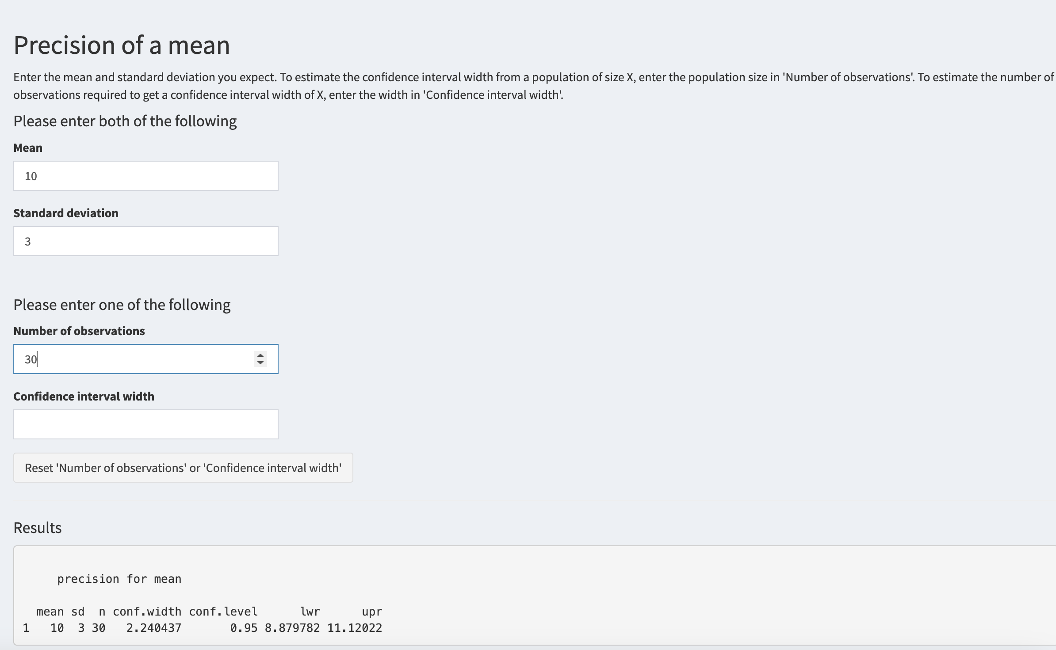
Precision exercise 1

Slide 54
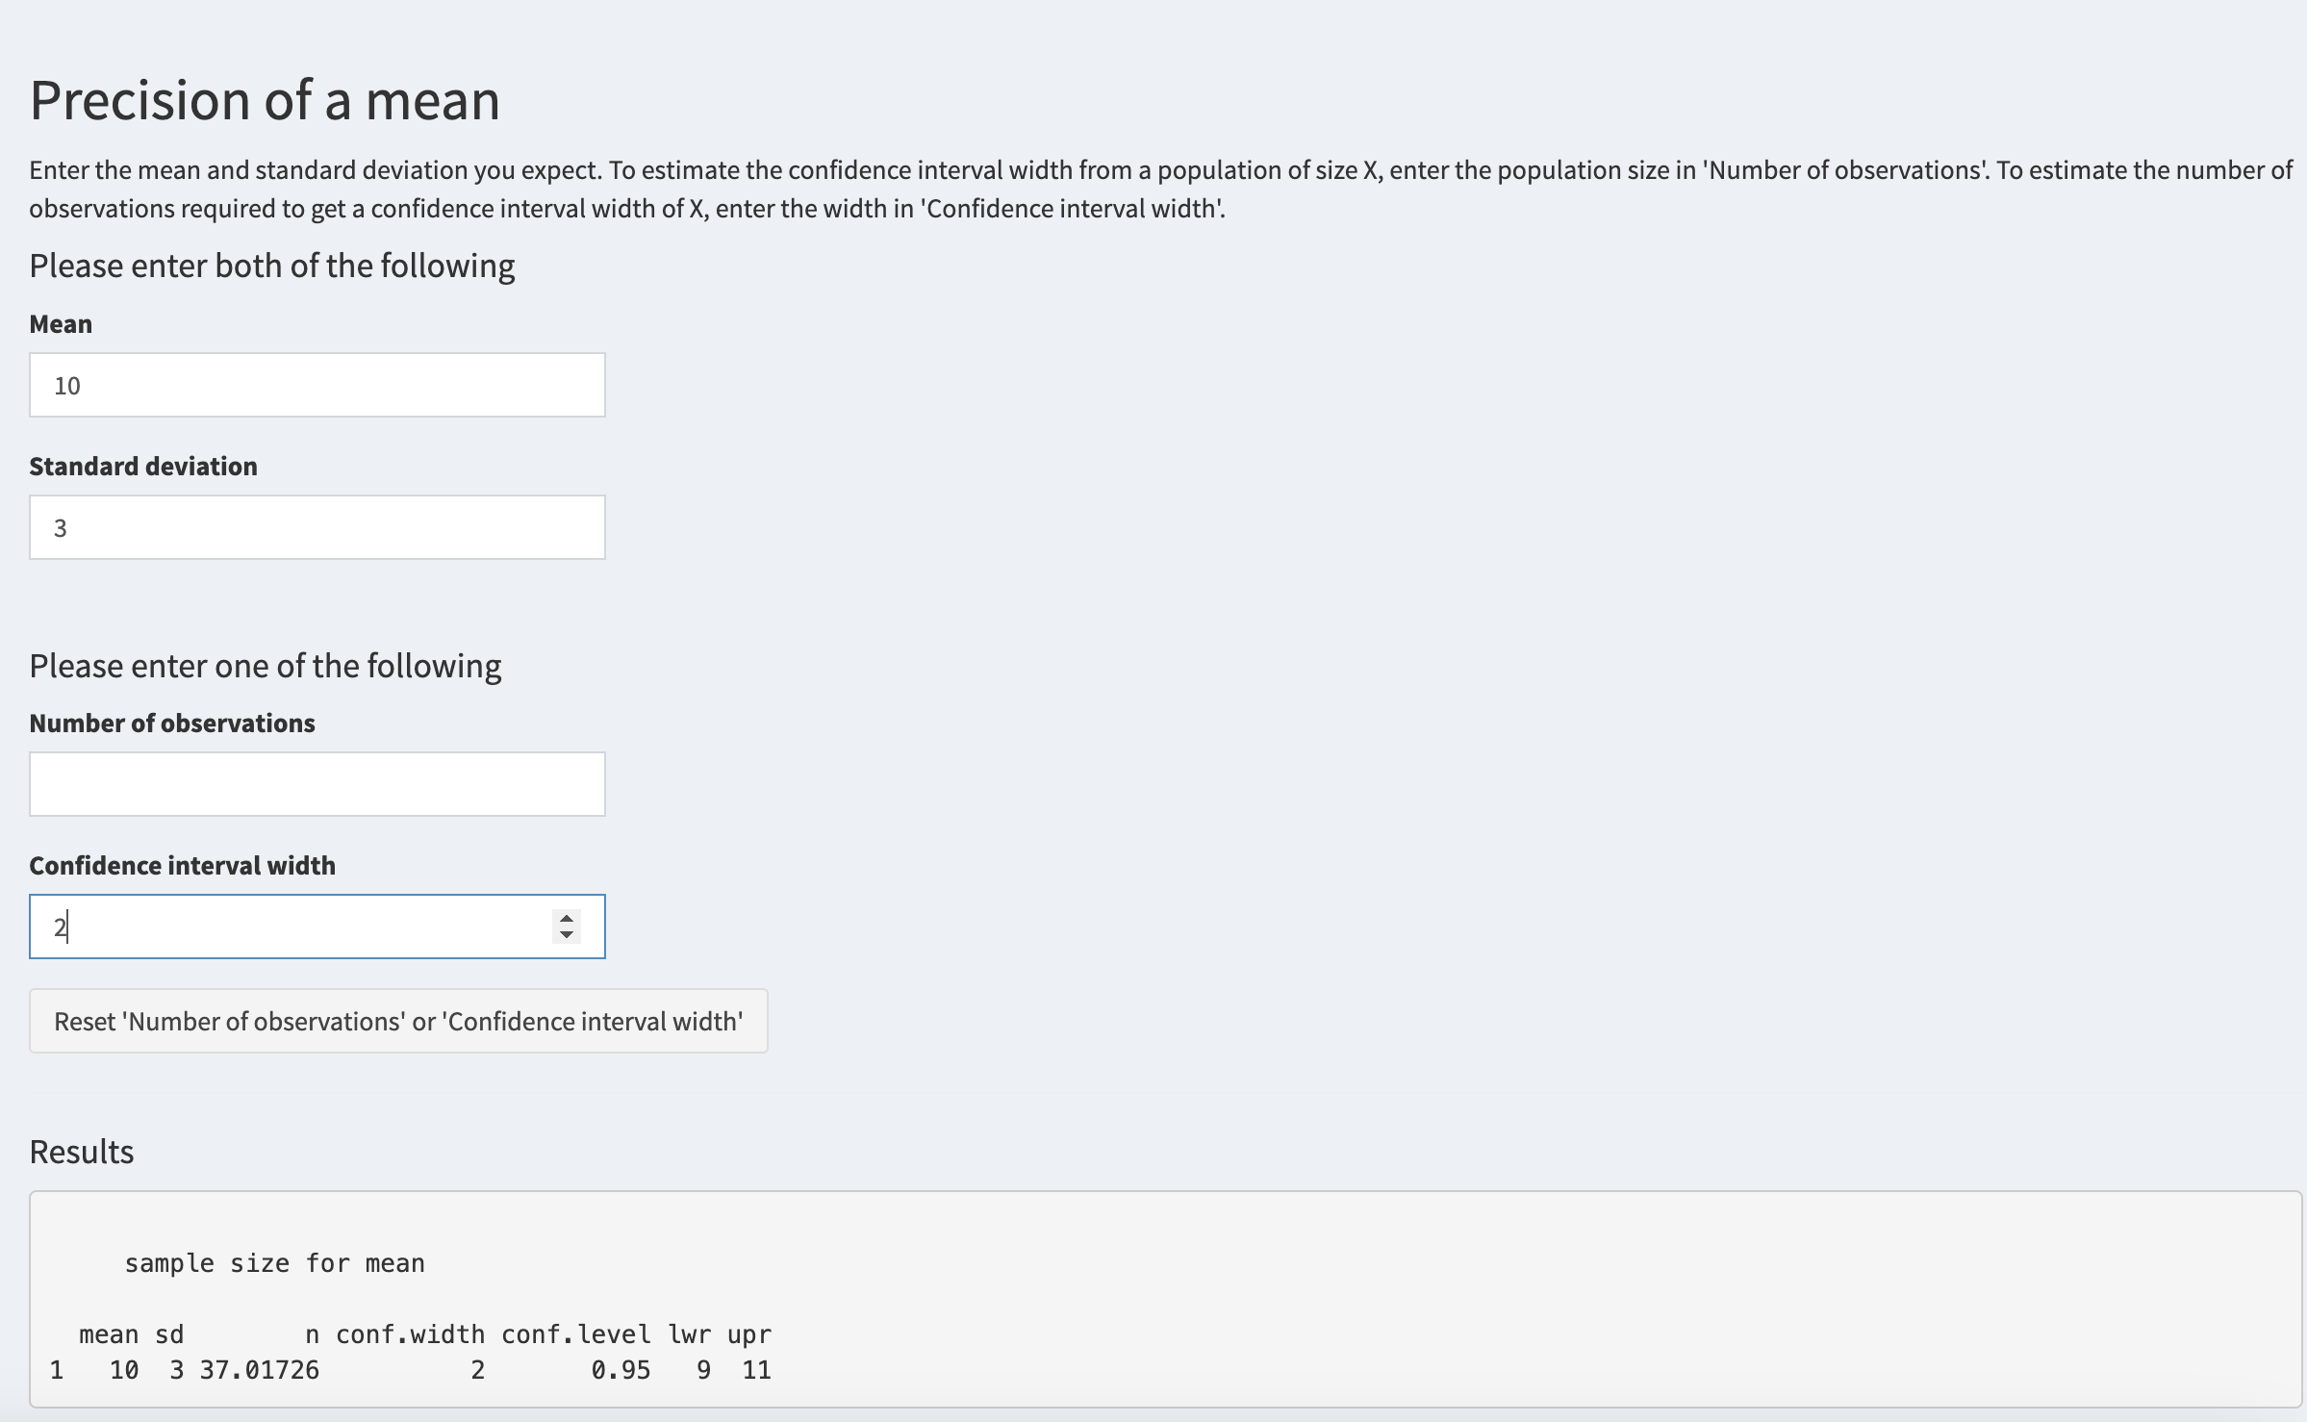
Precision exercise 2

Slide 55
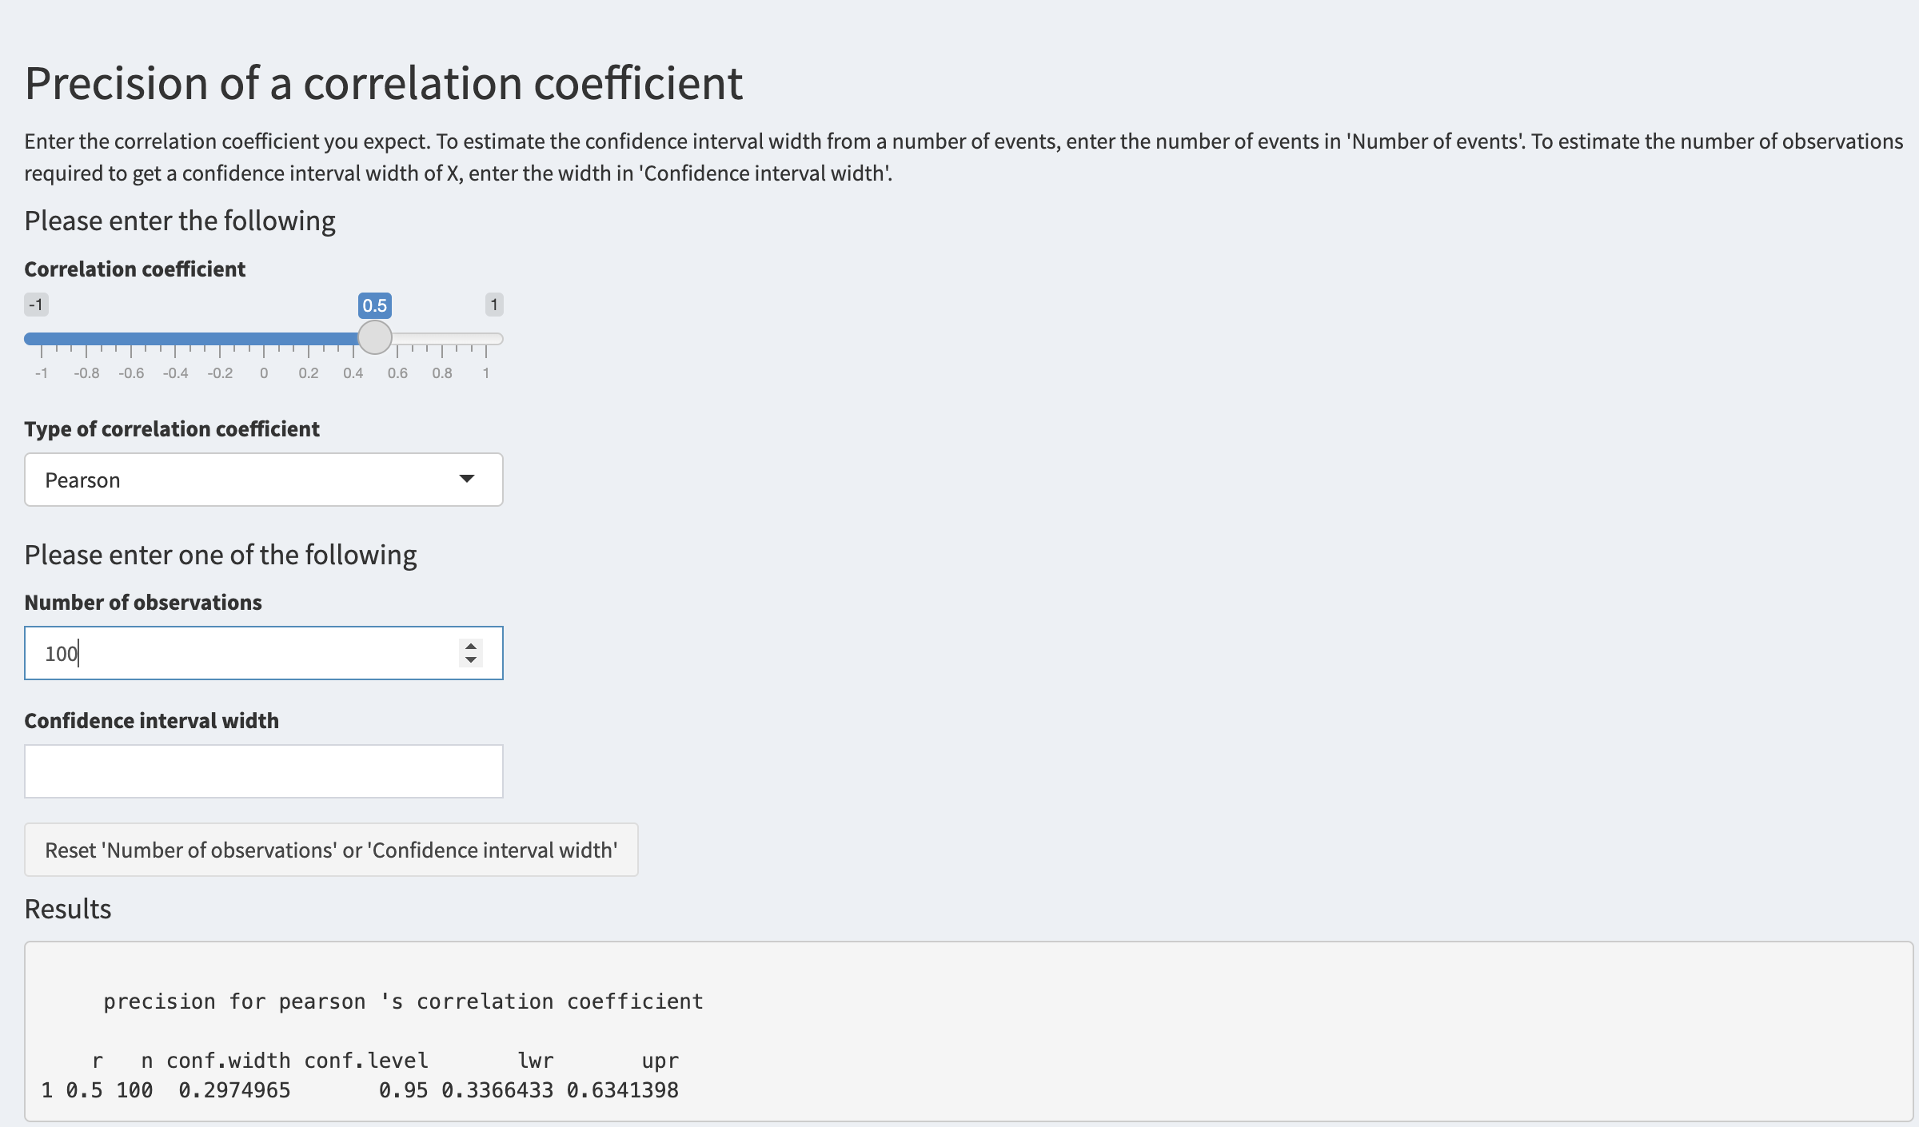
Precision exercise 3

Slide 56
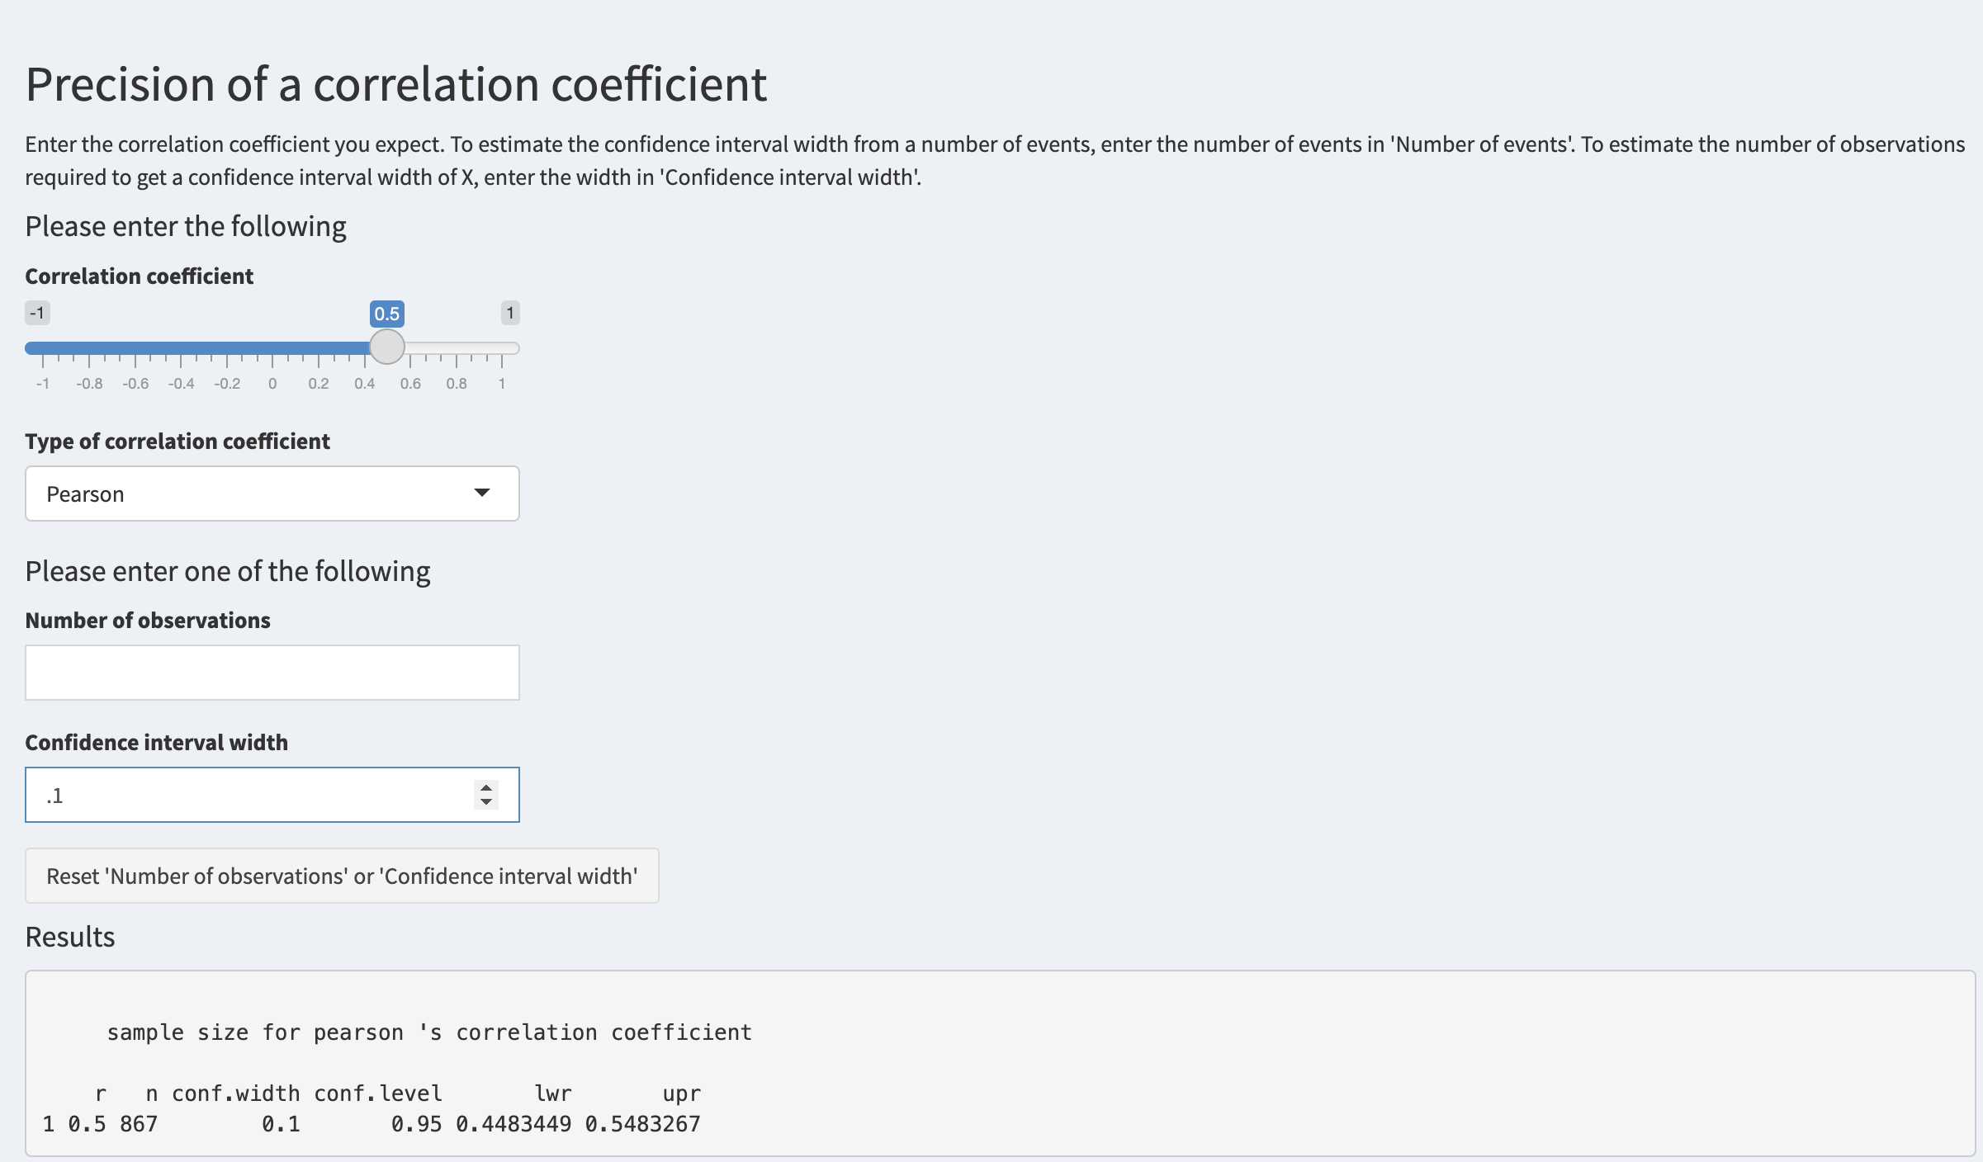
Precision exercise 4

Slide 57
Questions?

